Slide 2
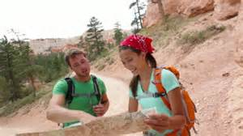
Outdoor Skills Objectives
Finding your direction
How to find your way without a compass or map
Using the night sky to find your way
Hiking safety
What to pack for day hiking
Being prepared for the unexpected
Questions

Slide 3
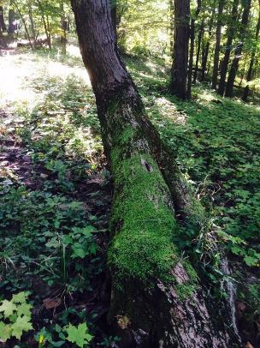
Finding your way without compass or map
Northern Hemisphere
Look at trees
North side of trees are shady, moss grows more in shade, so you can find north by looking where moss is thicker
Inspect the bark on older trees, thinner bark is usually facing southeast, also more foliage on that side
Deciduous trees tend to grow on the south side of hills
Evergreens grow on the north side

Slide 4
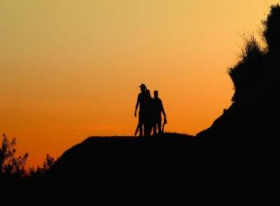
Tips without a compass or map
Look for snow:
North facing slopes have snow longer, or conversely south facing slopes show grass sooner as the sun melts it faster.
The sun:
Always rises in the east and sets in the west, in either hemisphere.
Lies due south at noon every day in the northern hemisphere and due north in southern hemisphere.
Anthills:
Ants tend to build on the warmer, sunnier south side.
***Note: Southern Hemisphere is directly opposite from above (mossier side of tree likely facing south, etc.).

Slide 5
Finding direction using the moon
Locate west using the moon
When moon rises before sunset, bright side is in the west when waxing (getting fuller)
Locate east using the moon
When moon becomes visible
after midnight, it is illuminated by
the eastern sun when waning
(getting smaller)
A waxing moon will be illuminated on the right side, and a waning moon will be illuminated on the left side
*** Note this is in Northern Hemisphere. In Southern Hemisphere everything is
opposite direction or reversed 180 degrees

Slide 6
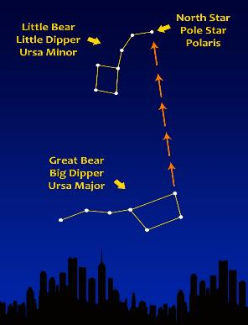
Finding direction using the stars
Using stars to locate north in northern hemisphere
Locate the Big Dipper and Little Dipper
Draw an imaginary line from the two pointer starts at base of bowl of big dipper to the last and brightest start in the handle of the Little Dipper under this star
North Star (Polaris) is this bright star, the North Pole lies directly under this star

Slide 7
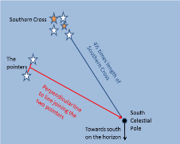
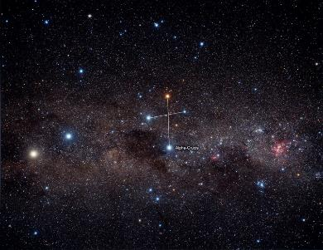
Finding direction in Southern Hemisphere
Locate the Southern Cross by siting a group of stars close together with 2 large pointer stars off to their side
Starting at the top of the group of 5 stars, take 4X the distance from the top star, straight down through bottom star
You will be facing south where bottom of line ends

Slide 8
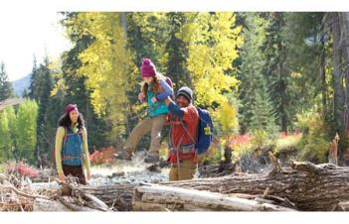
Day Hiking: what to put in your pack
Essentials
First Aid kit
Sunscreen
Water- approx. 3 quarts per person
Map and Compass
Comfortable shoes
Whistle
Food- High energy foods that won’t
fall apart easily: bagels, trail mix, apples, oranges, hard cheeses,
hard breads, jerky or hard salami, pepperoni stick
Always let someone know where you are going and when you will be returning!

Slide 9
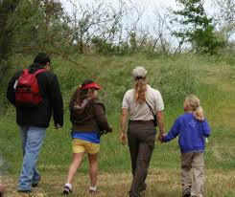
Day Hiking: What to Put in Your Pack
Additional items to consider bringing along:
Bug spray
Multi-purpose tool
Toilet paper
Flash light
Trash bag
Duct tape
Emergency blanket
Matches or fire starting tools
In mountains: prepare for unexpected inclement weather

Slide 10
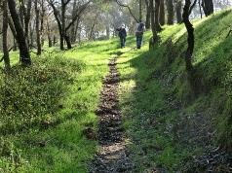
Unanticipated Outdoor Emergency Tips
Lighting a fire without matches
Using eyeglasses:
Far sighted glasses resemble a magnifying glass
With a lot of patience, your kindling will heat up and smolder
Spit on the lens, use the lens to angle the sun at a pile of kindling (dry leaves, twigs, or chips all make great kindling)
Blow very carefully on the fire to start the flame (must be sunny)
Using a water clear plastic water bottle:
Focus the sun's rays through the water so that it creates a single point of heat
Eventually, it will catch fire (must be sunny)

Slide 11
Resources for Fun Outdoor Activities
https://www.geocaching.com/ -- using GPS devices and maps online (like a global scavenger hunt)
Local orienteering clubs – look in your area
Apps for smart phones
Geocaching- (intro Version) Iphone/Android
Mobile first aid- includes a first aid manual, step by step first aid and emergency instructions
All Trails- Regardless of experience or skill level, over 50,000 trails (North America), each trail includes accurate reviews, photos and descriptions
Green Boot Pedometer- keeps track of how many steps you take

Slide 12
Questions?

Slide 13
Resources
http://www.bt.cdc.gov/preparedness/kit/disasters/
http://www.wildernesscollege.com/basic-survival-skills.html
http://lifehacker.com/5881604/be-a-grown-up-boy-scout-the-wilderness-survival-skills-everyone-should-know
http://www.mensfitness.com/training/endurance/12-outdoor-survival-skills-every-guy-should-master?page=2
http://www.extension.iastate.edu/article/plan-ahead-reduce-impact-natural-disasters
http://worksafecenter.com/safety/topic/emergency+preparedness/step-1.page?&gclid=COjNz_nOy8YCFQiQaQodV6UPfQ
http://www.wikihow.com/Read-a-Map
http://www.wikihow.com/Use-a-Compass
http://ccfpd.org/Education/Documents/ScoutWorksheets/findingnorthwithoutcompass.pdf
http://www.almanac.com/content/find-your-way-without-compass
http://www.getoutwiththekids.co.uk/family-hiking/teaching-kids-map-reading/
http://www.sydneyobservatory.com.au/2013/finding-south-using-the-southern-cross/
https://www.google.com/search?q=big+dipper+with+north+star017igM%252C_&dpr=1&usg
__http://neilsperry.com/2012/10/texas-tree-tips-october-2012/
https://www.google.com/search?q=free+photos+map+images+global;&espv=2&biw=1366&bih=643&tbm=isch&tbo=u&source=univ&sa=X&ved=0CDYQsARqFQoTCMmB3a7X7McCFUefgAodxlkAsA&dpr=1#tbm=isch&q=free+photos+roadmap+images+global%3B&imgrc=ww1UlnU1FQD2rM%3A
http://www.123rf.com/photo_31046470_asian-family-enjoying-walk-in-countryside.html?term=out
http://www.vidiani.com/maps/maps_of_australia_and_oceania/maps_of_australia/large_detailed_road_map_of_australia.jpg
http://www.harryanddavid.com/?ref=google_search_tm&cm_mmc=tm-_-google_search-_-TQE-TM-Branded_adgroup-_-keyword&gclid=CJP1n6bm7McCFQuQaQodYWkM9g
http://www.wikihow.com/Tell-Whether-the-Moon-Is-Waxing-or-Waning
http://www.ehow.com/how_2078611_read-road-map.html
https://www.google.com/search?q=public+domain+photos+of+southern+cross+in+night+sky/
http://www.loringrestoule.com/explore-our-nature/wild-berry-picking/

